Slide 1
Stronger Than They Know: Supporting Students of Color in Recognizing Common Obstacles & utilizing Resilience to Succeed in Higher Education
Dr. Natalie Young
College Changes Everything Conference
July 13th 2023

Slide 2
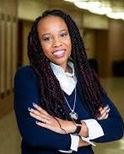
Hello!
Dr. Natalie Young
Northern Illinois University
College of Education
Special & Early Education
A
B
O
U
T
M
E
Always grateful
Bellwood raised
Opinionated
Underestimated
True Virgo
Mom
Educator

Slide 3
Say What?!?
“Graduate school is not for you.”
“This is America speak English!”
“You’re in the wrong class.
Here I’ll help you, let me see your schedule.”
“I’m 23 and you’re the first Black teacher I have ever had.”

Slide 4
Stats & Figures
In 2012, fewer than 20% of men of color in America had a 4 year college degree.
Higher education is a key pathway to upward social mobility.
Microaggressions
can cause students to experience serious cognitive, behavioral, and emotional reactions, making it very difficult for them to learn
Black college students are twice as likely to have additional responsibilities as caregivers or full time workers in addition school.
When compared
to other groups of color, Black students have been found to be the group that is most negatively impacted by discrimination and systemic racism. Resulting in the lowest completion rates.
1st Generation students of color are twice as likely to leave college before completion.

Slide 5
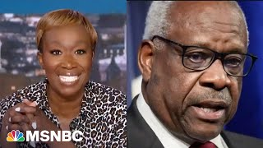
Affirmative Action
Ended affirmative action (AA)
AA Misunderstood
Admits unqualified students
Standards set out… students must meet those standards (including grades and test scores)... only then are decisions made about what the institution would like to see to enrich the lives of all students through diversity and lived experiences
Diverse classrooms benefit all

Slide 6
Let’s Think About iT….
What are some obstacles faced by students of color when achieving a college degree?

Slide 7
Research Suggests…
Are common obstacles for POC
Facing racial discrimination by multiple stakeholders (faculty, peers, and staff)
Additional financial responsibilities & family obligations
Consistent burden of ensuring positive representation of people of color (POC) in predominantly white institutions (PWIs)
Unfamiliar w/information and skills needed for success in higher education
Consistent school experiences of microaggressions and feelings of being unsafe and disrespected
Feelings of isolation and being the “Only”

Slide 8
Overcoming These Obstacles
Racial discrimination
Additional Responsibilities
Representing for All
Deliberately training faculty in culturally responsive teaching
Train to acknowledge biases
Operate from a value lens not a deficit mindset
Recognize that Black girls are not actually magical
Purposeful mentorships with similar backgrounds

Slide 9
Overcoming These Obstacles
Lack of understanding navigating higher ed
Microaggressive
Acts
Being the “Only”
Financial aid office staff trained in cultural sensitivity
Our responsibility to ensure students of color know how to navigate systems in place
Allyship trainings made available to faculty, students and staff
Strategically create and fund mentorships initiatives that connect SOC w/ mentors of color w/ similar backgrounds
Provide safe spaces
Designing for Belonging from enrollment to graduation

Slide 10
So What Else Can We Do?

Slide 11
It’s So Much More than Just a Cliche
C
Consistently show up
A
Affirm students of color
R
Resist complacency
E
Educate yourself

Slide 12
Acknowledge & Take Action
1 & 1 Activity: GOAL
Promote the success of Students of Color in higher education
Write down 1 thing you would like to start doing
Write down one thing you would like to STOP doing

Slide 13
Questions Please

Slide 14
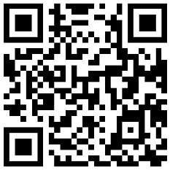
THANK YOU !
Dr. Natalie Young
nyoung@niu.edu
Link to today’s Slidedeck

